Slide 1


SQL Project
Finance and Supply Chain Analytics at AtliQ Hardware.
Presented to – AtliQ Hardware
Presented by – Aashutosh Marathe

Slide 2
Company Business Model Problem Statement Project Summary Report Conclusion
Objectives

Slide 3
AtliQ Hardware is a company that supplies computer hardware and peripherals to many clients such as surge stores, Nomad stores, etc. across India. AtliQ Hardware’s head office is situated in Delhi, India and they have many regional offices throughout India.
Company

Slide 4
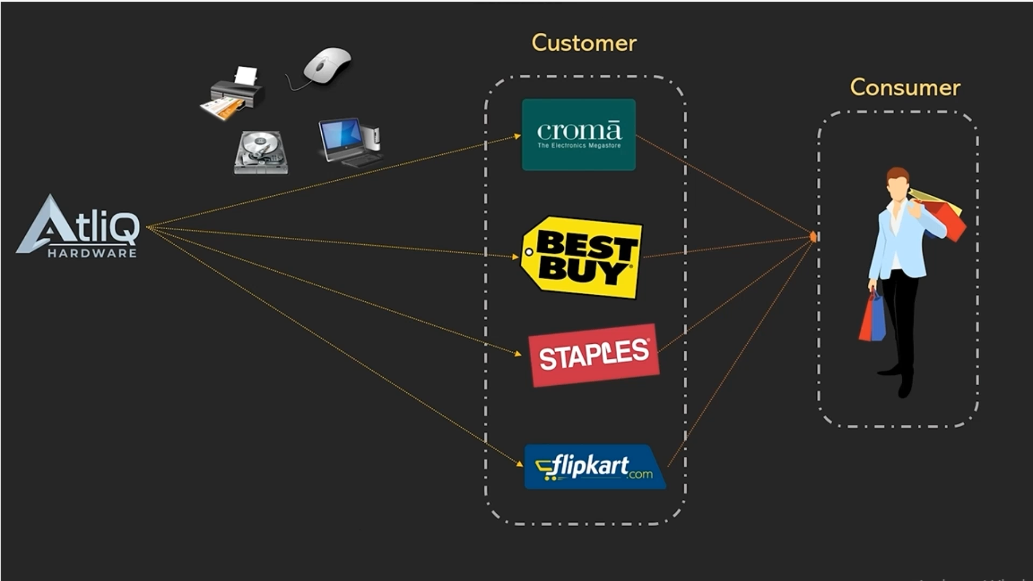
Business Model

Slide 5
Problem STATEMENT AND Project Summary
Problem Statement - Atliq Hardware a leading computer hardware producer faced a challenge and they want to gain insights into their top customers, Products, and Market according to fiscal years for the performance check.
Project Summary - In this project, my focus will be on analyzing a dataset and gaining the top performer for the company according to the fiscal year.

Slide 6
REPORT
Database gdb0041
Tables
Dim_customer
Dim_product
Dim_date
Fact_forecaste_montly
Fact_freight_cost
Fact_gross_price
Fact_manufacturing_cost
Fact_post_invoice_deduction
Fact_pre_invoice_deduction
Fact_sales_montly

Slide 7
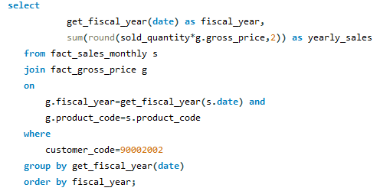
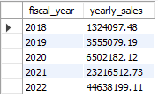
Total Gross Sales amount In Every year from Croma

Slide 8
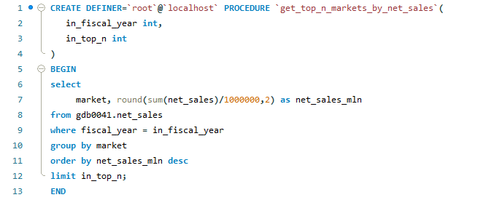
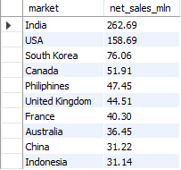
Use of Stored Procedures
Top 10 Market by net sales

Slide 9
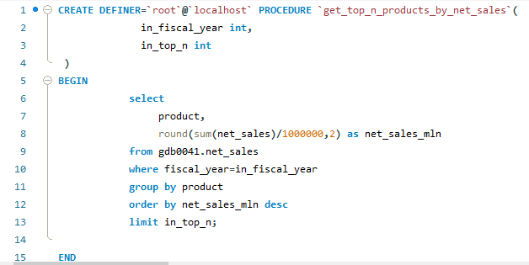
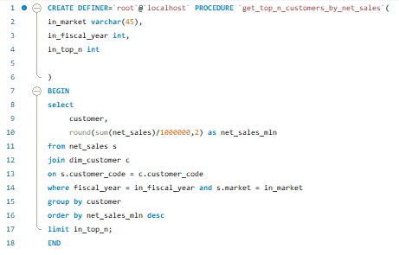
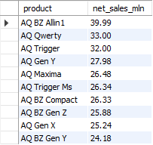
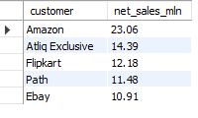
TOP 10 products by Net Sales
TOP 10 Customers by Net Sales

Slide 10
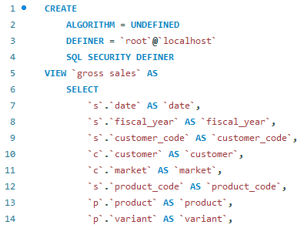
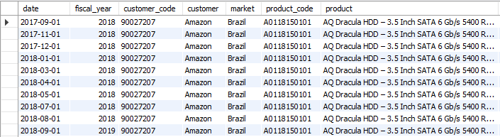
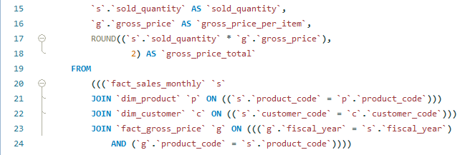
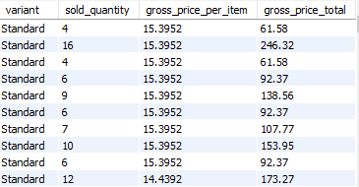
Use of Views
Gross Sales

Slide 11
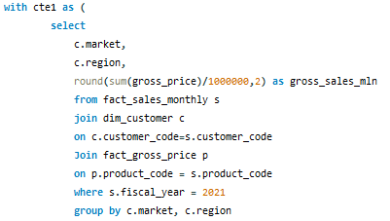
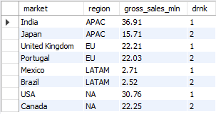
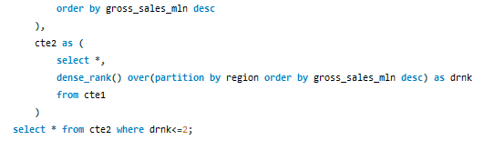
Retrieve the top 2 markets in every region by their gross sales amount in FY=2021.

Slide 12
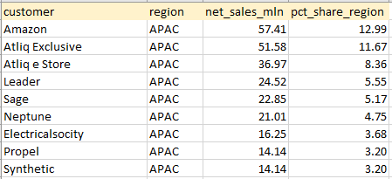
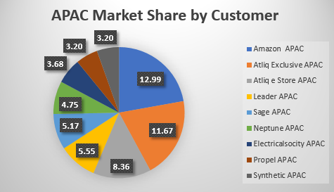
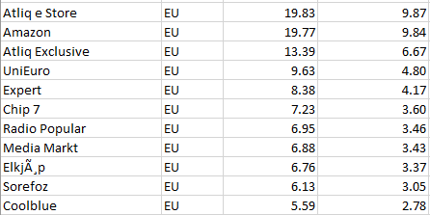
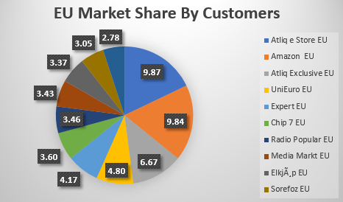
Region-wise market share visuals
APAC REGION
EU REGION

Slide 13
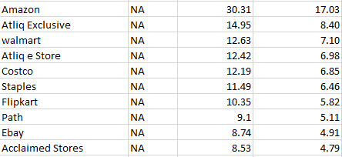
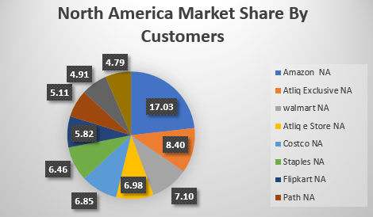
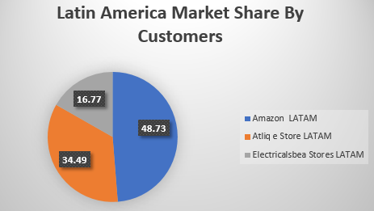

NA ( North America) REGION
LATAM ( Latin America) REGION

Slide 14
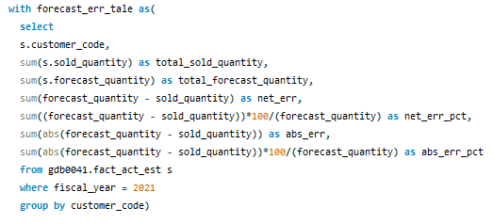
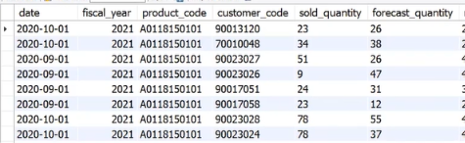
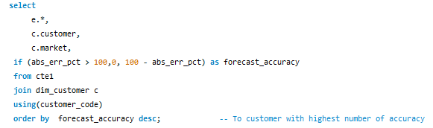
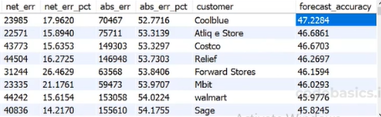
Supply Chain Analytics
The supply chain business manager wants to see which customers’ forecast accuracy for 2021. Provide a complete report.

